Slide 1

Identifying Best Value For Money Hotels In Goa

Slide 2
About us
Member-1:
Santhosh kumar
I have recently completed my B.tech in the stream of computer science and engineering. Now I have done my Data Analytics course at INNOMATICS RESEARCH LABS
Member-2:
Vandanapu Lalitha Sai Kumar
I have recently completed my B.tech in the stream Information Technology. Now I have done my Data Analytics course at INNOMATICS RESEARCH LABS
Member-3:
Balasai
I have recently completed my B.tech in the stream of Electronics and communication engineering. Now I have done my Data Analytics course at INNOMATICS RESEARCH LABS

Slide 3
Objective of the Project
To Identify Which Hotels In Goa offer best value for maoney, providing higher customer satisfaction at relatively low price

Slide 4
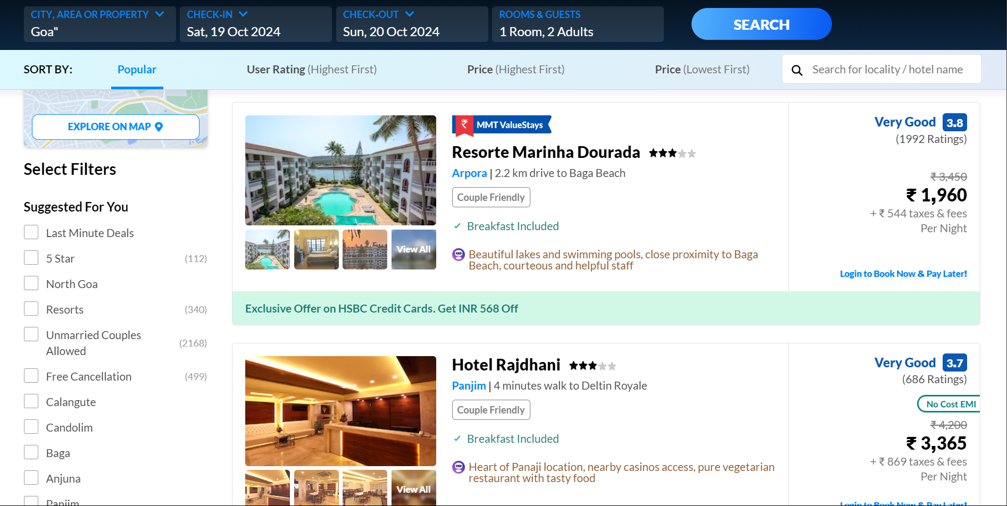
Website
We had done web scrapping on Make My Trip Website to get the data:

Slide 5
Webscrapping:
By using Regex Expressions, we performed data scrapping on the Make My Trip website.
After scrapping We took columns like Hotels, Location, Ratings,
No_of_Ratings, Original_price, Discounted_price, Taxes, House_Rule, House_type
Now, we had Ninecolumns,480 rows in the dataframe

Slide 6
Dataset Overview
The dataset contains around 12 features and 818 independent variables.
The dataset contains 7 numerical 5 categorical columns.
Each hotel is uniquely identified in the dataset

Slide 7
DataFrame:

Slide 8
Data Cleaning:
Data cleaning is the most essential to ensure accuracy and quality in Analysis.
After Successfully importing the data , We started cleaning the data.
We have checked the null values and duplicated values and Unwanted columns.
After checked we started cleaning the data , by dropping the duplicate values and unwanted columns and assigned the NaN values with appropriate values in appropriate columns.

Slide 9
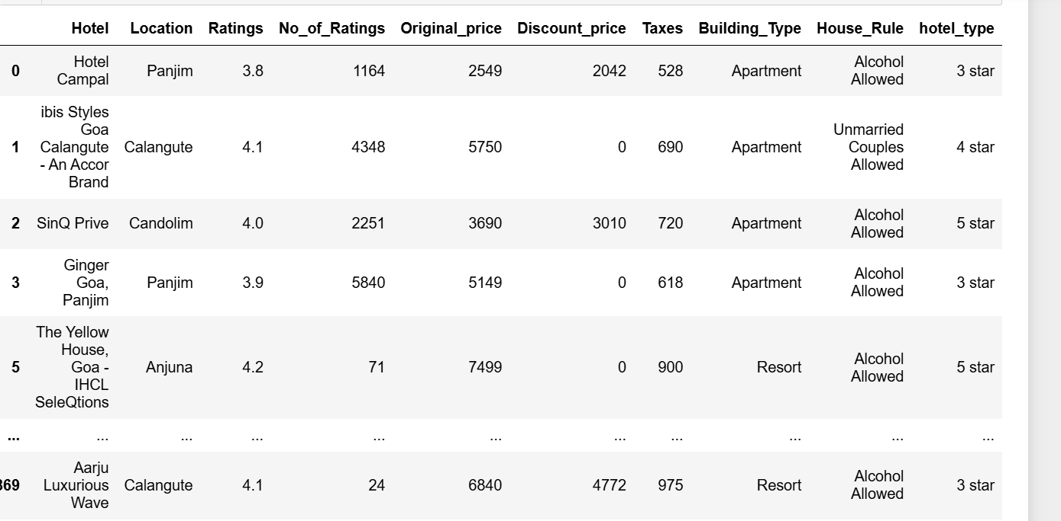
DataFrame after performing data cleaning:

Slide 10
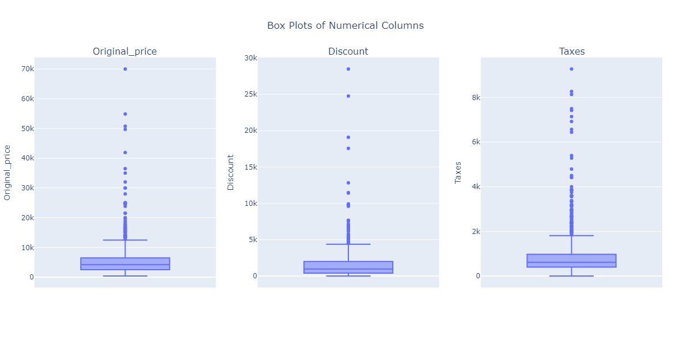
Univariate Analysis - Numerical Box plot
All three distributions (discounted prices, taxes, and original prices) are skewed to the right, meaning there are a few items with very high prices.
Higher discounted prices often correspond to higher taxes.

Slide 11
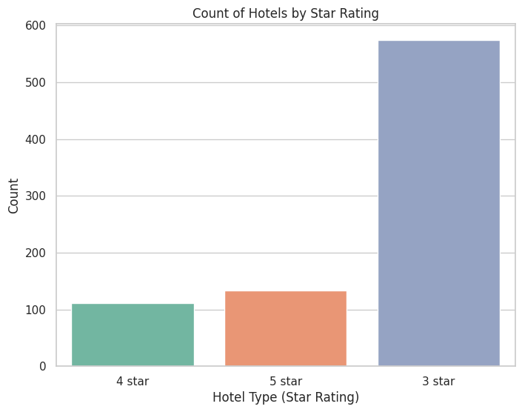
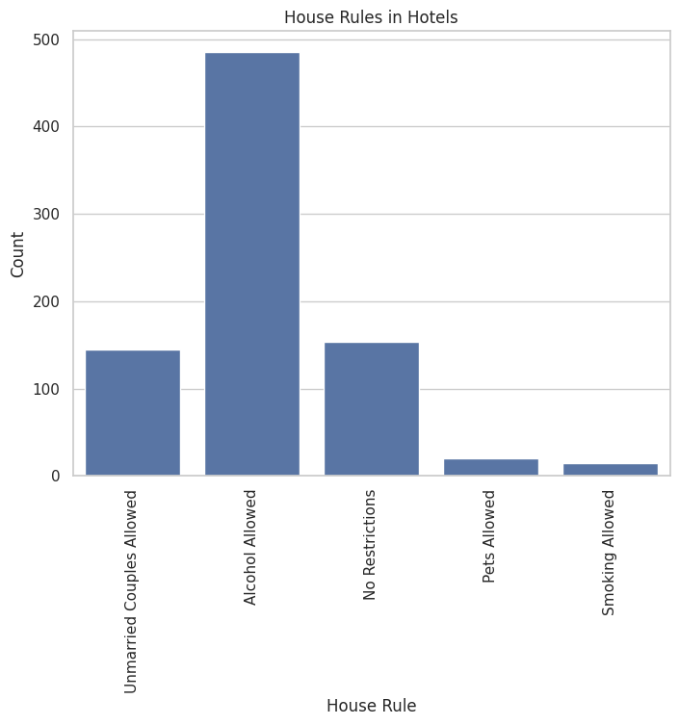
Univariate Analysis - Categorical Count plot
Most hotels in Goa are 3-star, offering comfortable stays at reasonable prices, while high-end 4-star and 5-star luxury hotels are fewer and harder to find.
Most hotels in Goa allow alcohol and welcome unmarried couples, but few hotels permit pets or smoking, indicating these practices are less common.

Slide 12
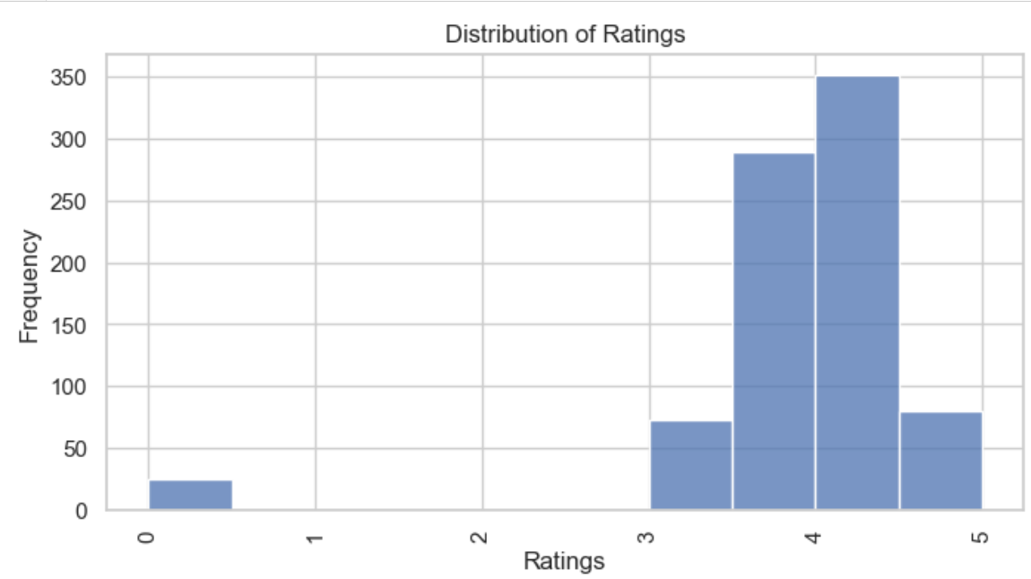
Univariate Analysis - Categorical Count plot
Most hotels have ratings between 4 and 5, indicating positive customer experiences, while very few hotels received low ratings (below 3), suggesting that overall hotel satisfaction in Goa is high, with only a small number of poorly rated hotels.

Slide 13
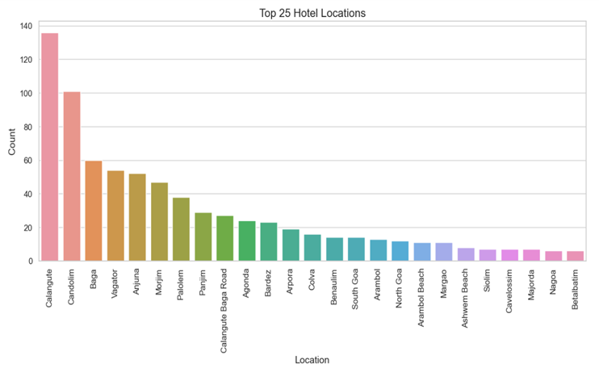
Univariate Analysis - Categorical Count plot
Calangute and Candolim are the most popular hotel locations in Goa, followed by mid-tier areas like Baga , Vagator , Anjuna, and Morjim.
Quieter locations such as Betalbatim , Nagoa , and Majorda have fewer hotels, with most top hotel spots concentrated in North Goa, while South Goa is less represented.

Slide 14
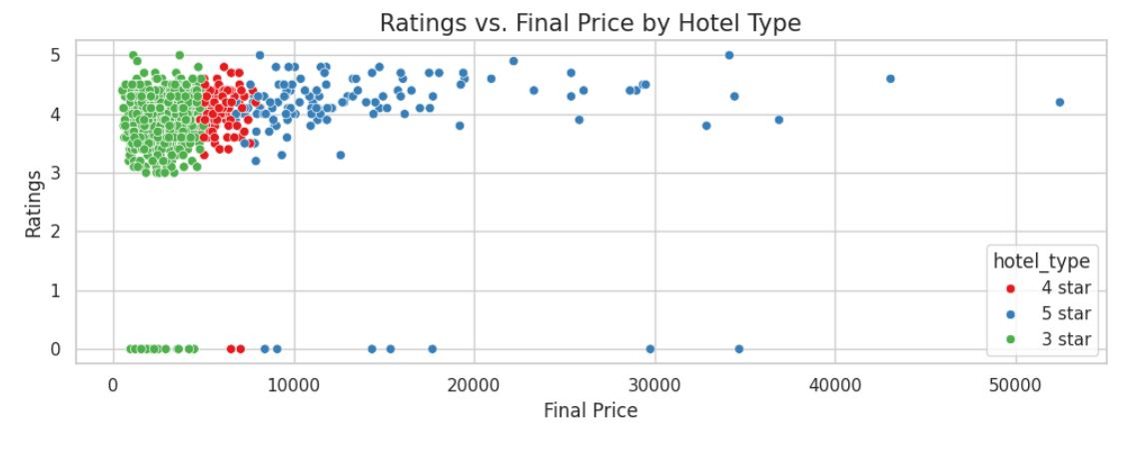
Bivariate Analysis – Numerical vs Numerical
5-star hotels tend to have both high ratings and high prices, while 4-star hotels show more variation in both, and 3-star hotels generally have lower ratings and prices, with a few outliers where some expensive hotels have lower ratings.

Slide 15
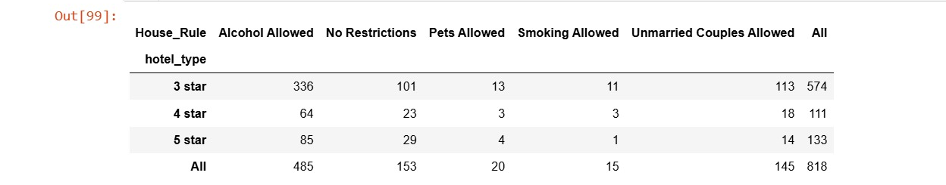
Bivariate Analysis – Categorical vs Categorical
Distribution of House Rules by Hotel Type

Slide 16
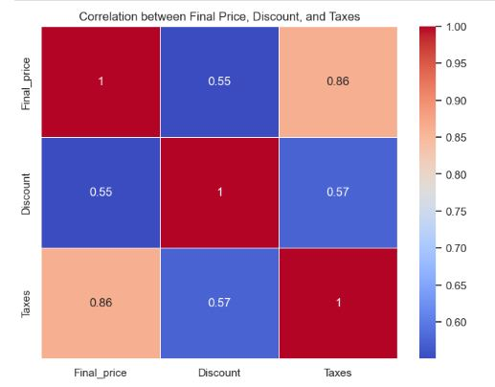
Bivariate Analysis – Numerical vs Numerical

Slide 17
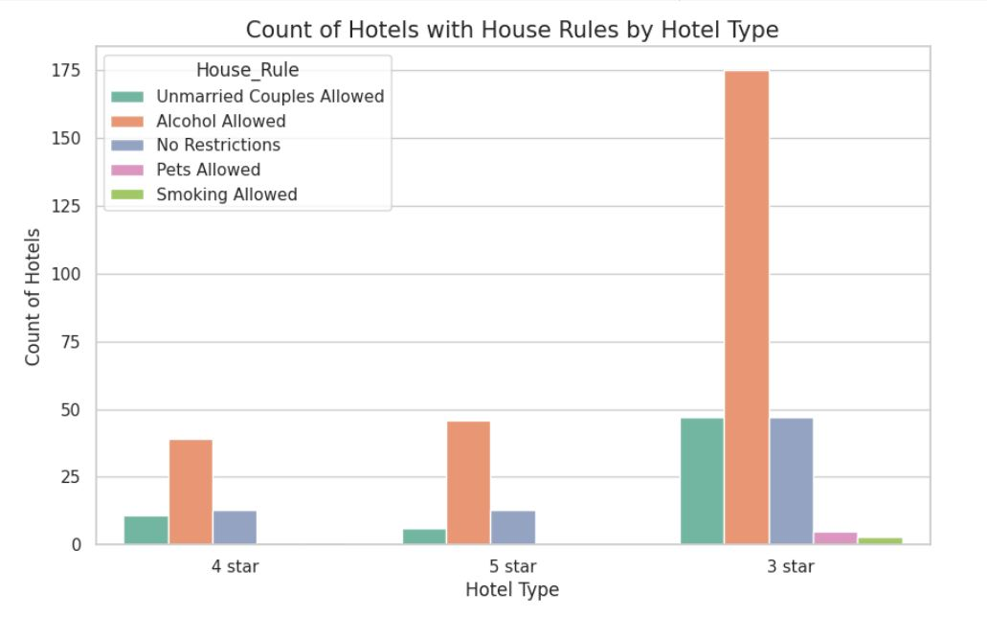
Bivariate Analysis – Categorical vs Numerical

Slide 18
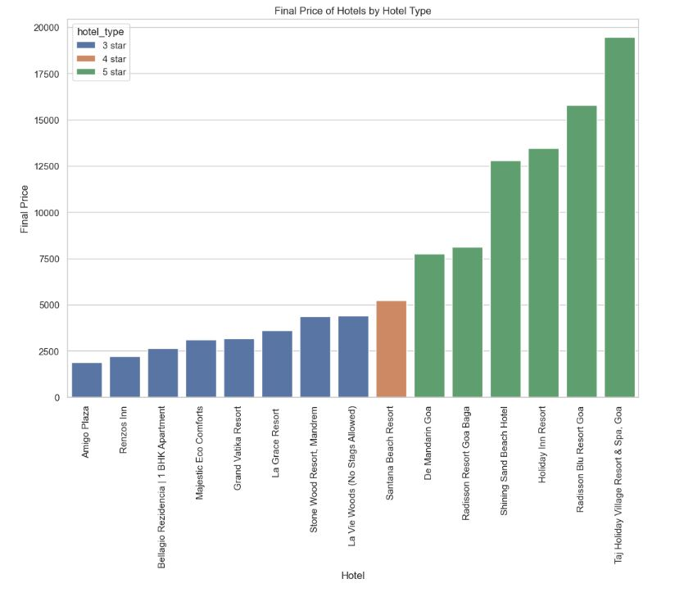
Observations:

Slide 19
Conclusion
The majority of hotels have final prices below 10,000 rupees.
There are a few hotels with exceptionally high final prices, exceeding 15,000 rupees.
The final price of a hotel is significantly influenced by its star rating. 5-star hotels are generally more expensive than 3-star hotels.
3-Star Hotels: Typically priced lower than 4-star and 5-star hotels. Most are below 5,000 rupees.
4-Star Hotels: Have a wider range of prices. The most common price is around 5,000-7,500 rupees.
5-Star Hotels: Generally the most expensive. Many are priced above 10,000 rupees

Slide 20

THANK YOU

